Slide 1
BM C4W
Eduardo Ortega

Slide 2
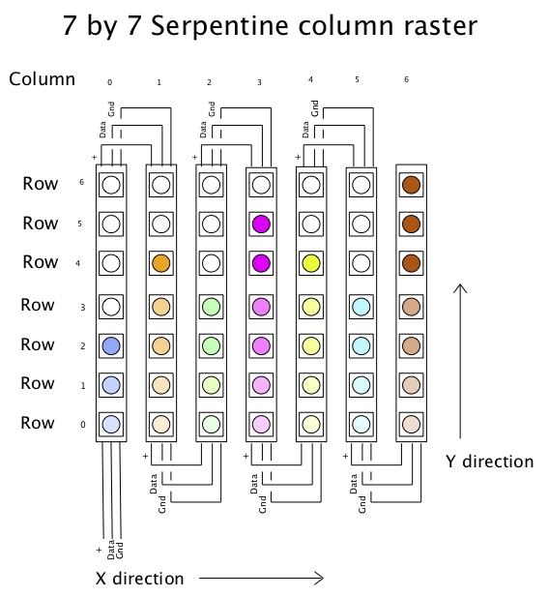
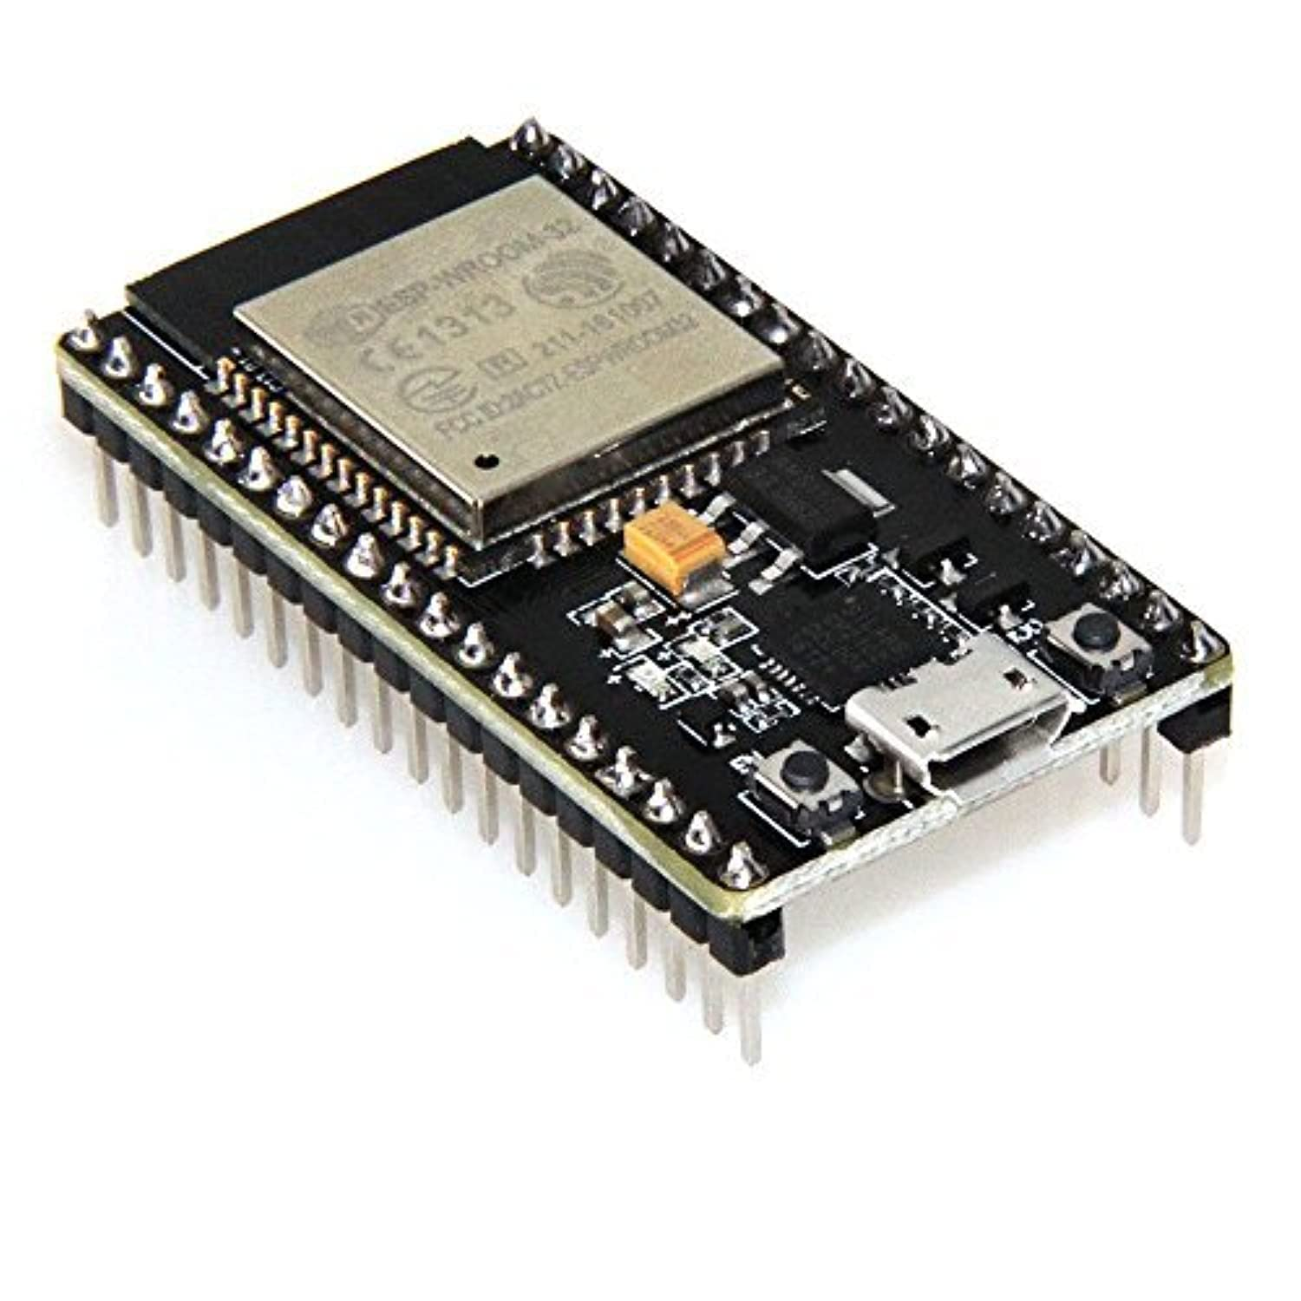
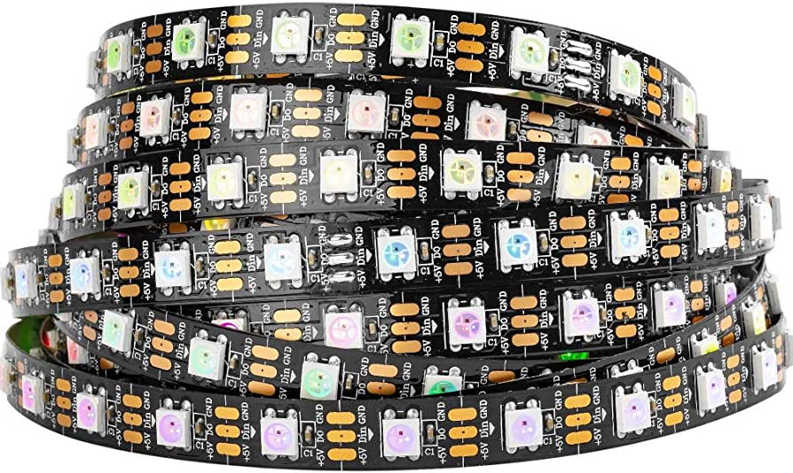
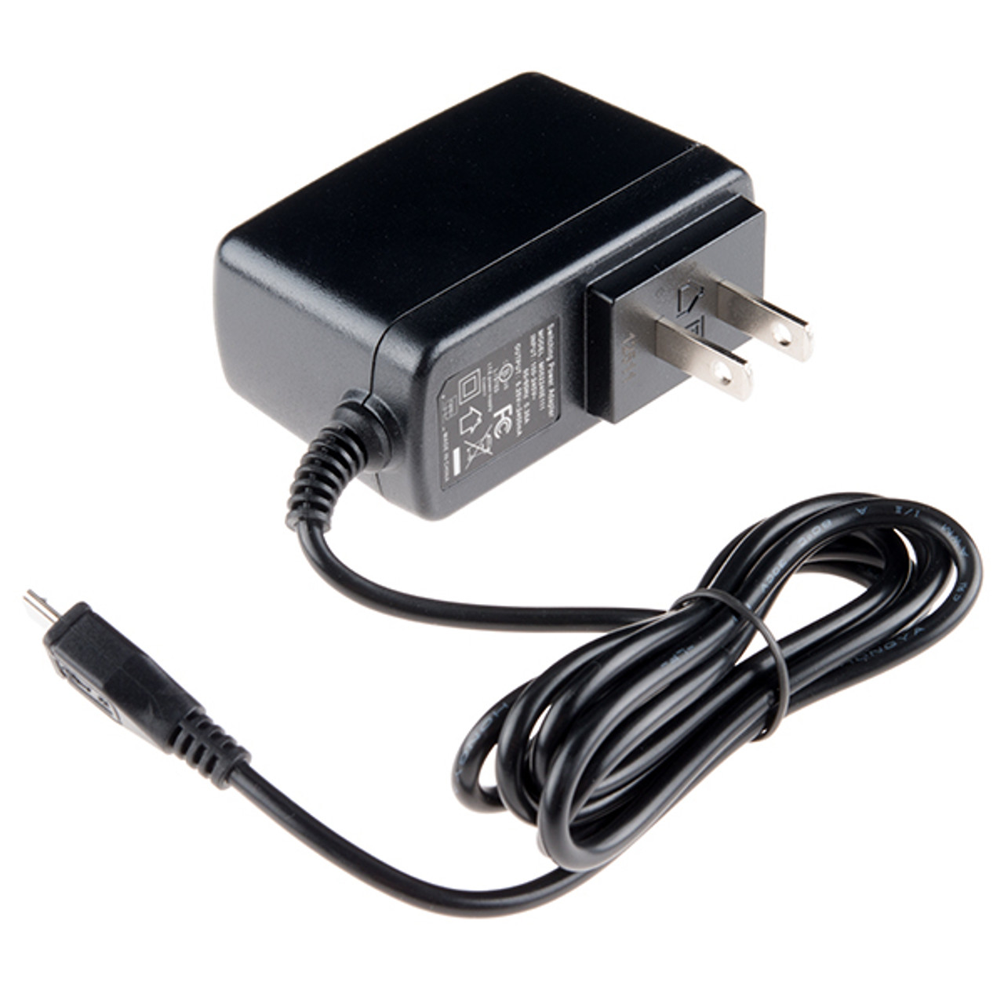
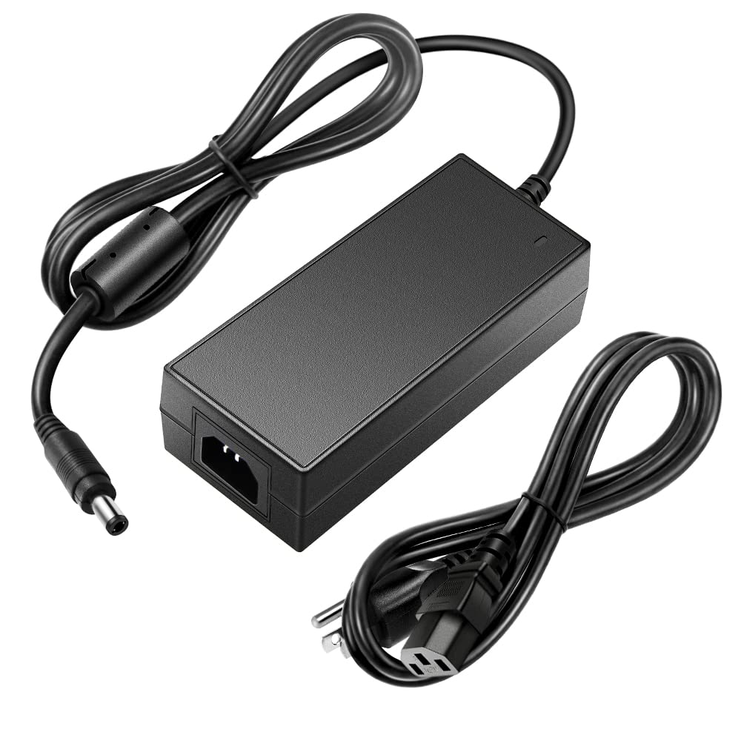

General Wiring Layout
Block Level Diagram
Serpentine Layout
DATA
GND
Power
Power
$$LED daisychain⇒ \left\{H, W\right\}⇒\left\{\begin{aligned}H is num LED per strip \\ W is num of Strips\end{aligned}\right.$$
$$\left\{H_{sign}, W_{sign}\right\}⇒\{13, 15\}⇒195 LEDs per daisychain$$
$$\left\{H_{totem}, W_{totem}\right\}⇒\{19, 10\}⇒190 LEDs per daisychain$$

Slide 3
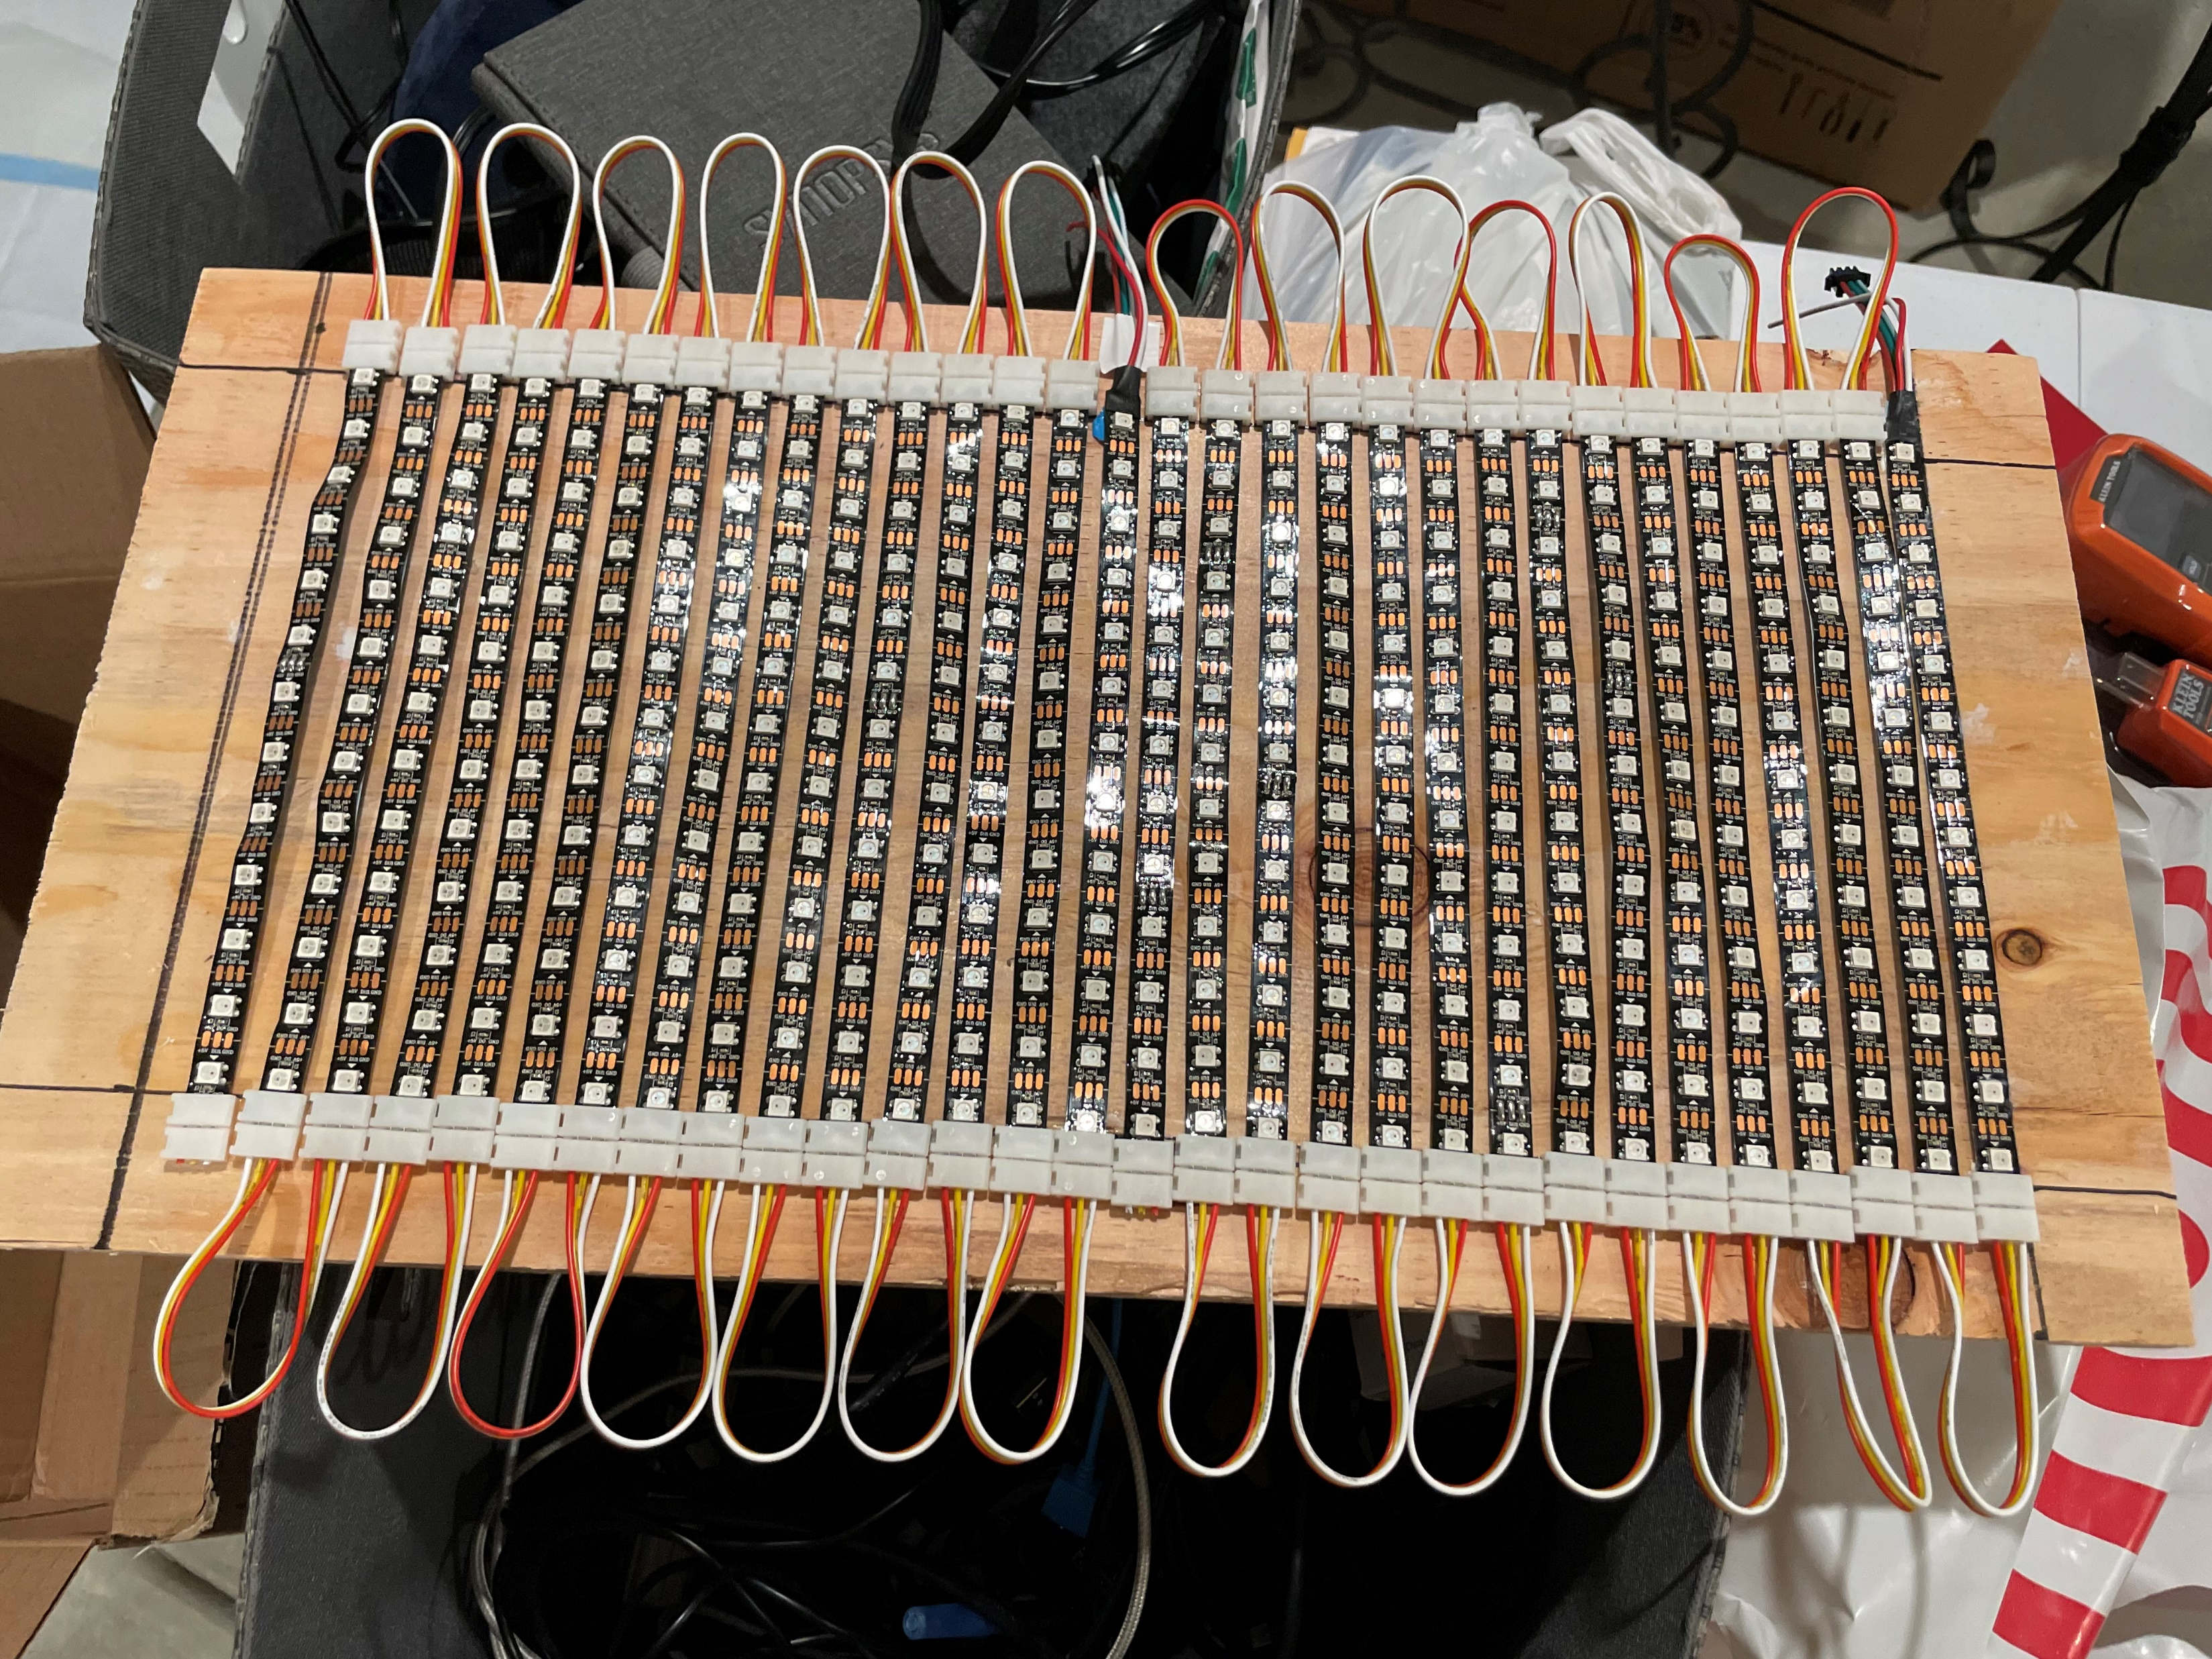
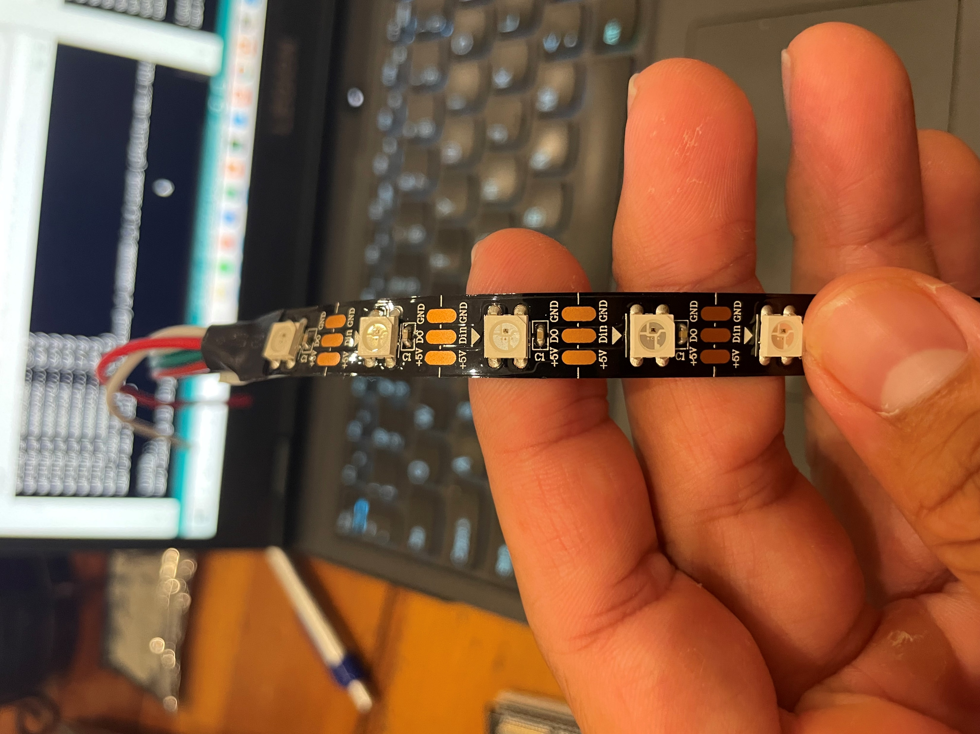
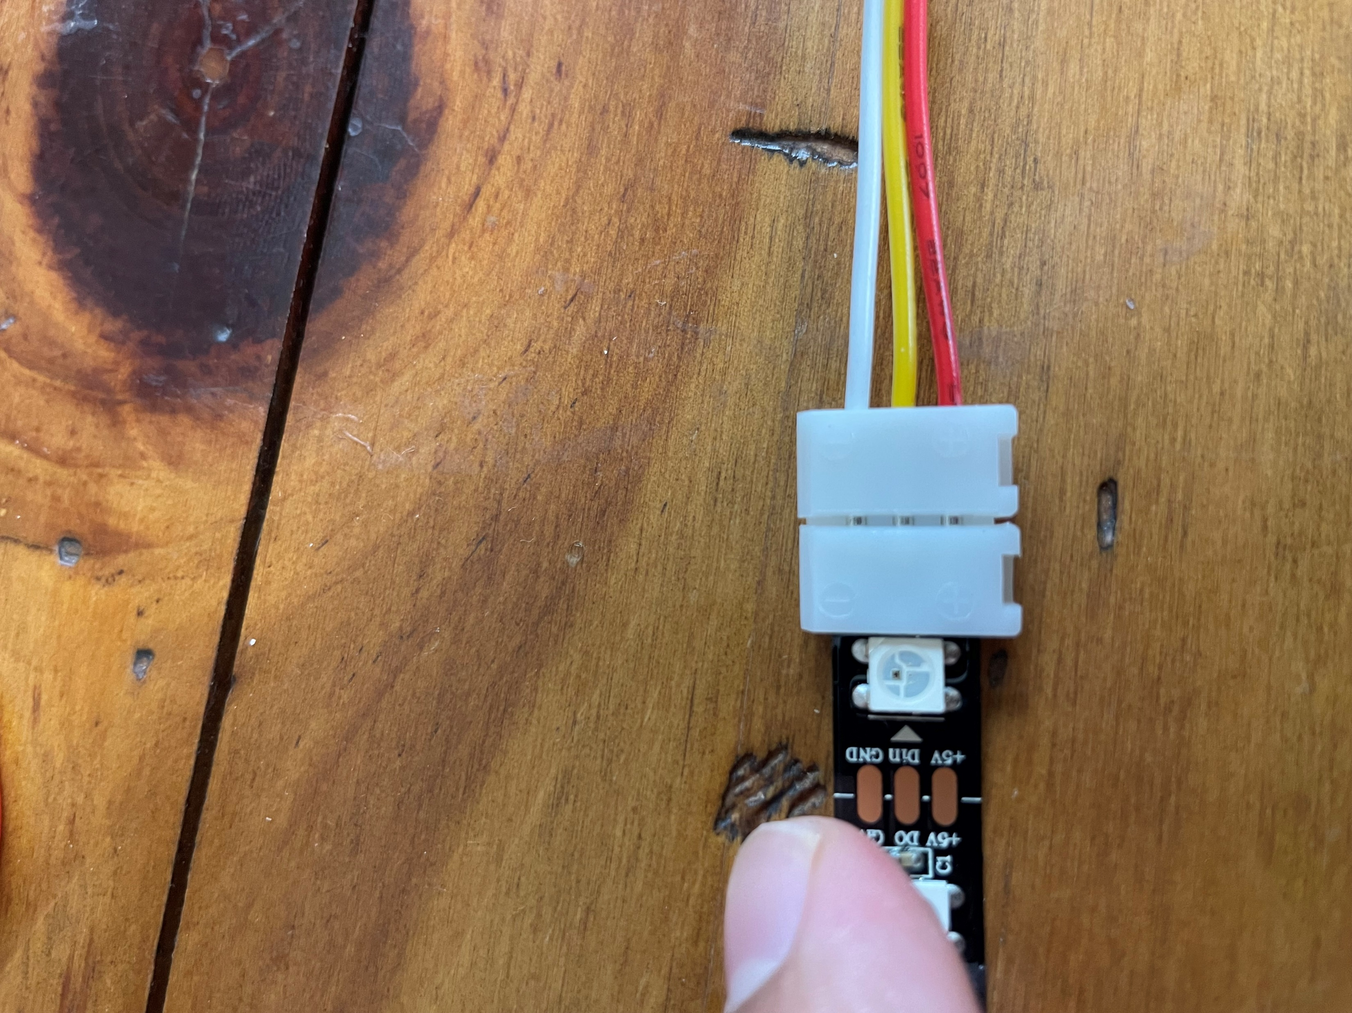
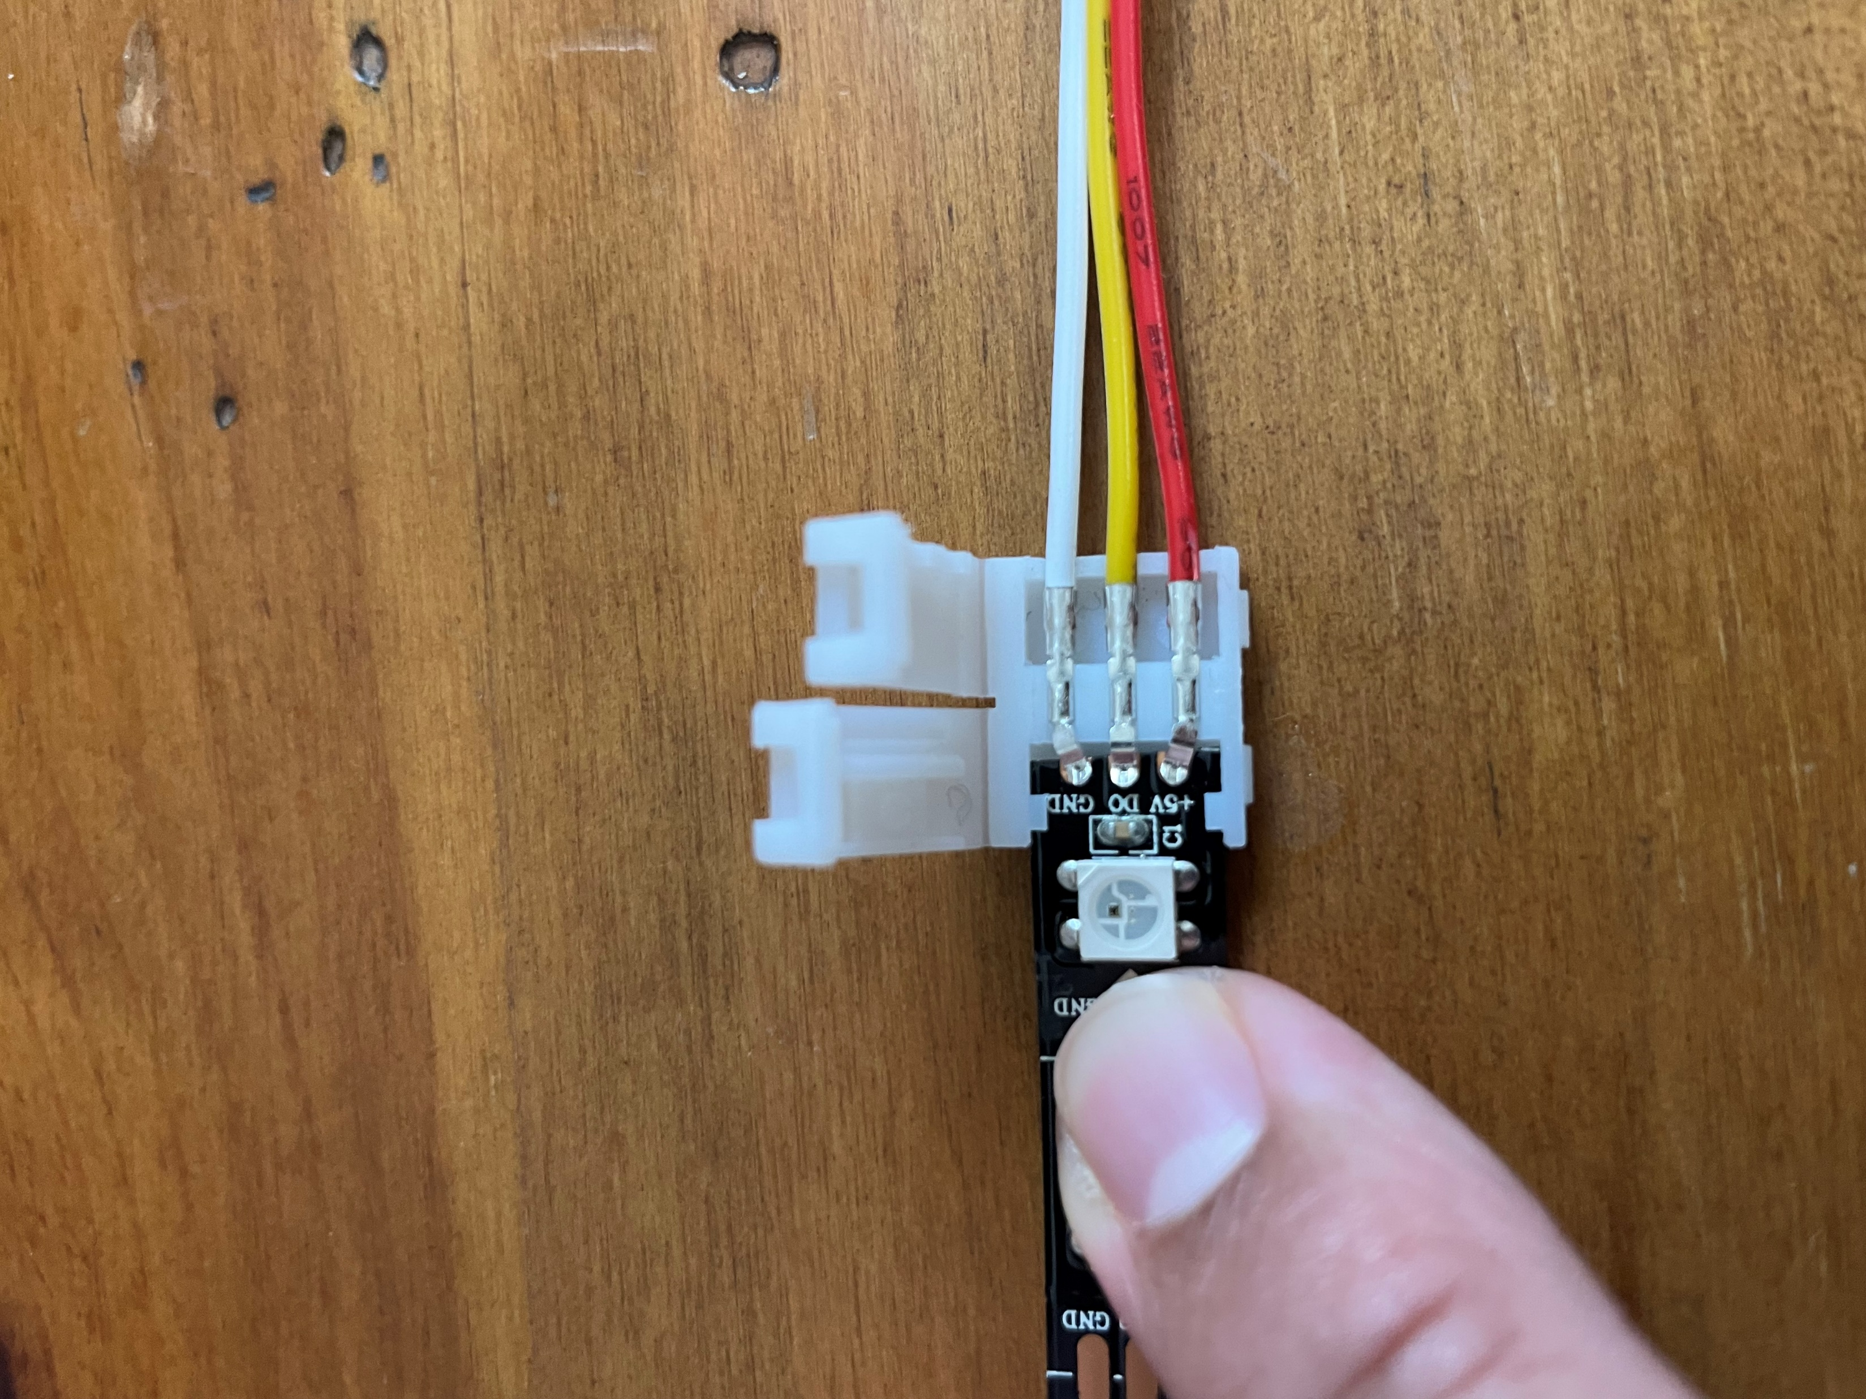
Things to look out for | Dust, Electrical contacts, etc.
Open
Closed

Slide 4
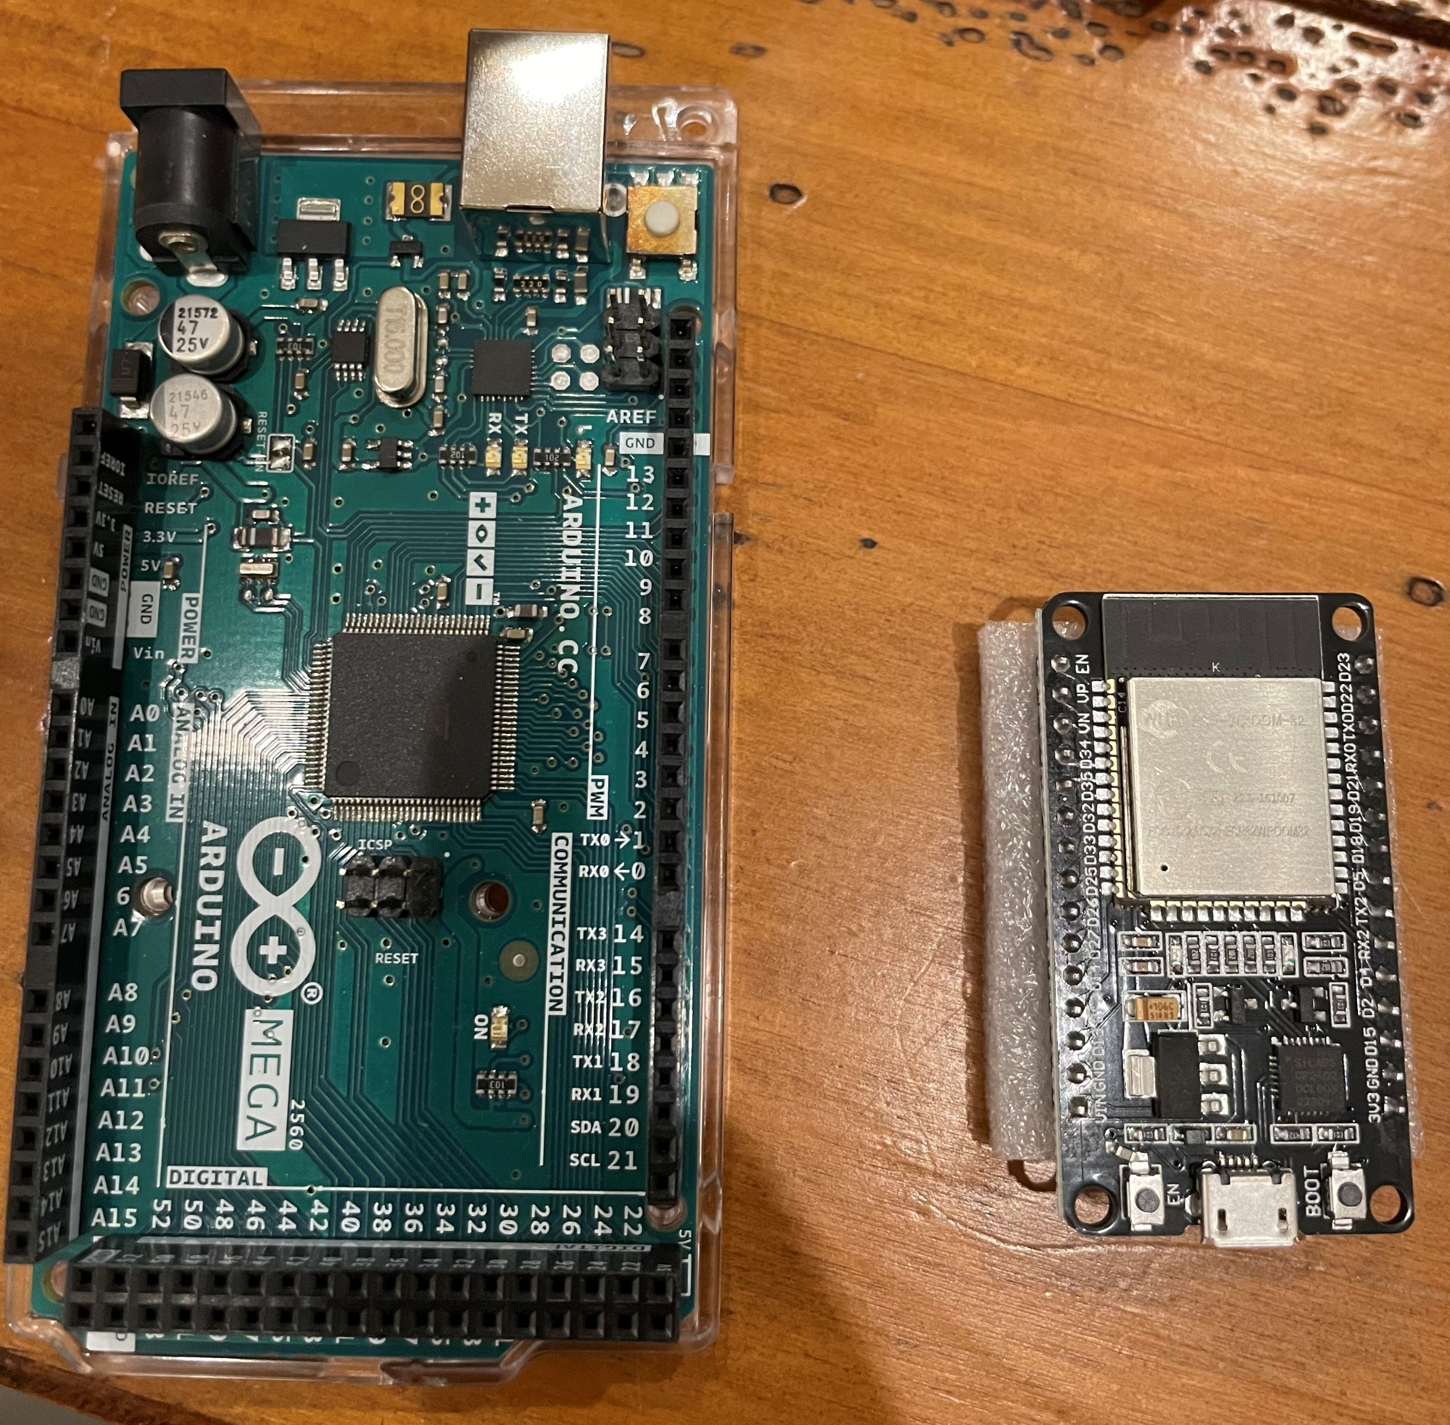
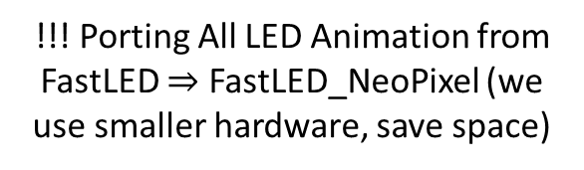
Progress Thus Far
Electronics Progress
% of est. work
LED Panel | LED Cutting (25%) | Wiring (50%) | Gluing (20%) | Protect (5%)
NO (9%) | Done | Done
YES (14%) | Done | Done | Done
WAIT (18%) | Done
MAYBE (22%) | Done
Totems (x4) (37%) | Done
% of
LED strips
!!! Porting All LED Animation from FastLED $⇒$ FastLED_NeoPixel (we use smaller hardware, save space)
Software Progress
LED Animation
Base animation done
Port to the new library IP
Bells and whistles (last priority)
BLE Stack
Ping Pong done
Orchestrator BLE flow IP
Integration E2E
Button received
Sanity testing E2E IP
Final integration E2E (not yet)
General Notes
Hosting volunteer days in Sacramento for general build
Experimenting with Polyurethane as an insulating material to protect electrical contacts
Number of outlets needed (29); Power strips, and extension chords - who can bring some?
Need a volunteer to help me on the playa

